Slide 1

SCSA1502-COMPUTER NETWORKS AND DESIGN
UNIT II UNDERLYING LAN CONCEPTS

Slide 2

LAN connectivity for small businesses – Integration – Token-Ring – Ethernet – ATM LAN emulation – InterLAN Switching – LAN to Mainframe – Building networks.
UNIT II UNDERLYING LAN CONCEPTS
Notes:
vdaac

Slide 3

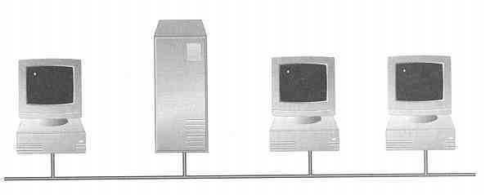
Basics of Network
Network, in computer science, a group of computers and associated devices that are connected by communications facilities.
Network is an inter connected collection of autonomous computers
When two or more computers are joined together so that they are capable of exchanging information , they form a network.
Notes:
vdaac

Slide 4
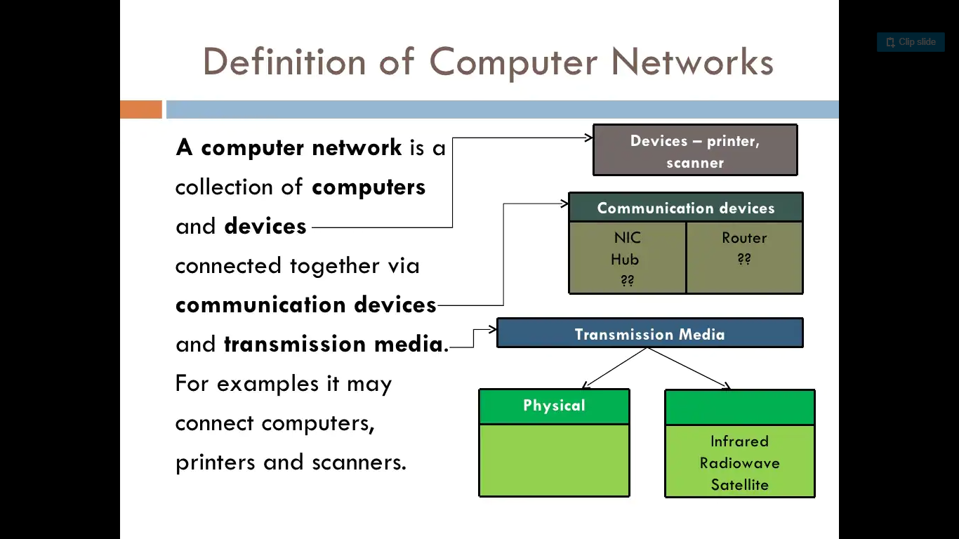
Definition of computer networks

Slide 5
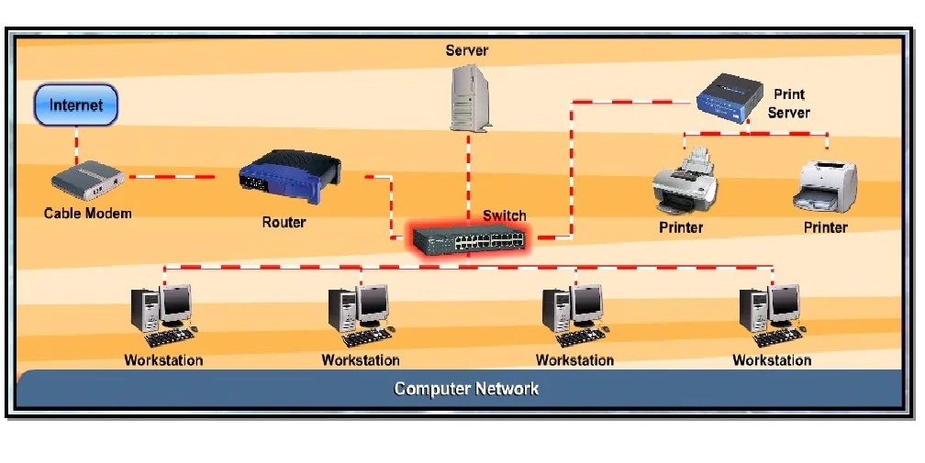
Typical network architecture
Notes:
vdaac

Slide 6
Need for Networking
Resource sharing -Through a network , data , s/w and h/w resources can be shared irrespective of the physical location of the resources and the user.
Reliability – A file can have its copies on two or more computers of the network
Reduced Cost – Sharing resources reduces the cost
Fast Communication – Information can be exchanged at a very fast speed

Slide 7

SWITCHES
A switch (switching hub) in the context of networking refers to a device which filters and forwards data packets across a network.
Unlike a standard hub which simply replicates what it receives on one port onto all the other ports, a switching hub keeps a record of the MAC addresses of the devices attached to it.
When the switch receives a data packet, it forwards the packet directly to the recipient device by looking up the MAC address.
A network switch can utilise the full throughput potential of a networks connection for each device making it a natural choice over a standard hub.
In other words, say for instance you had a network of 5 PCs and a server all connected with 10Mbps UTP cable, with a hub the throughput (10Mbps) would be shared between each device, with a switch each device could utilise the full 10Mbps connection.

Slide 8
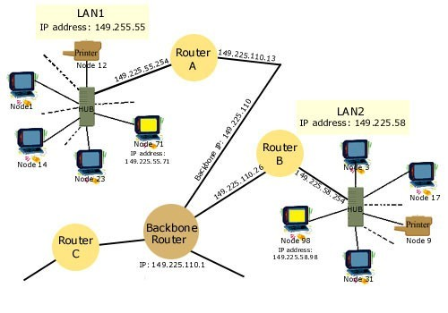
ROUTERS
A router is a device or a software in a computer that determines the next network point to which a packet should be forwarded toward its destination
Allow different networks to communicate with each other
A router creates and maintain a table of the available routes and their conditions and uses this information along with distance and cost algorithms to determine the best route for a given packet
A packet will travel through a number of network points with routers before arriving at its destination

Slide 9
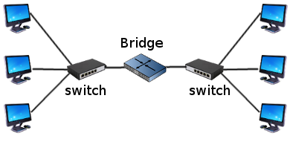
BRIDGES
A bridge is a product that connects a local area network (LAN) to another local area network that uses the same protocol (for example, Ethernet or token ring)
A bridge examines each message on a LAN, "passing" those known to be within the same LAN, and forwarding those known to be on the other interconnected LAN (or LANs)

Slide 10
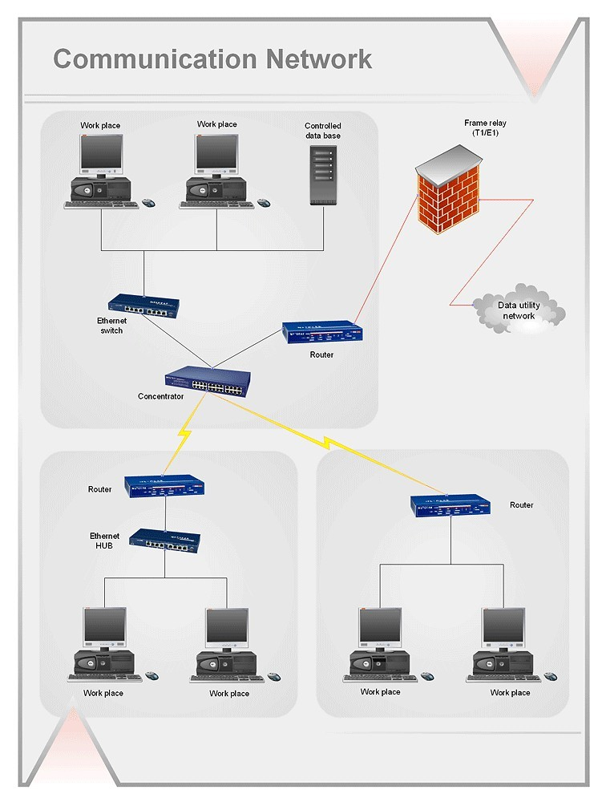
GATEWAY
Gateway is a device that connects dissimilar networks.
Establishes intelligent connection between a local network and external networks with completely different structures

Slide 11
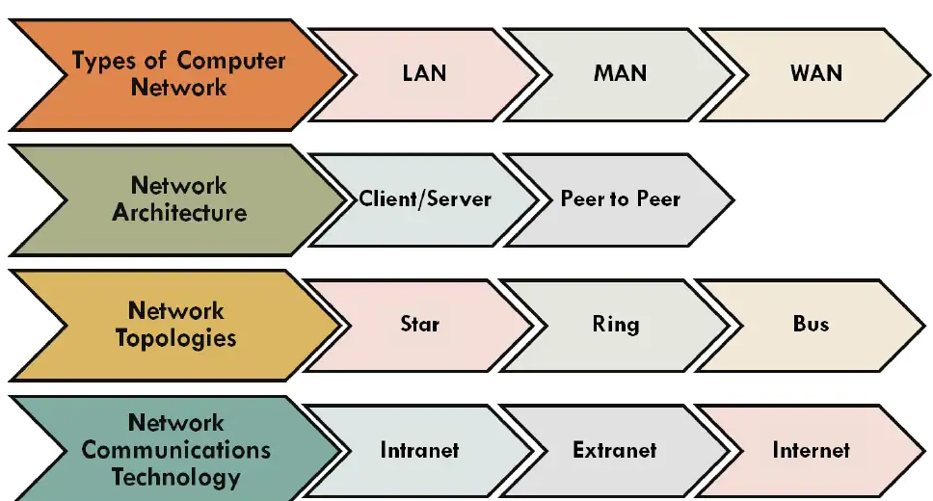

Slide 12
Types of Computer Networks
Networks are classified depending on the geographical area covered by the network
Computer Networks
Local Area Network
(LAN)
Campus Area Network (CAN)
Metropolitan Area Network (MAN)
Wide Area Network
(WAN)

Slide 13
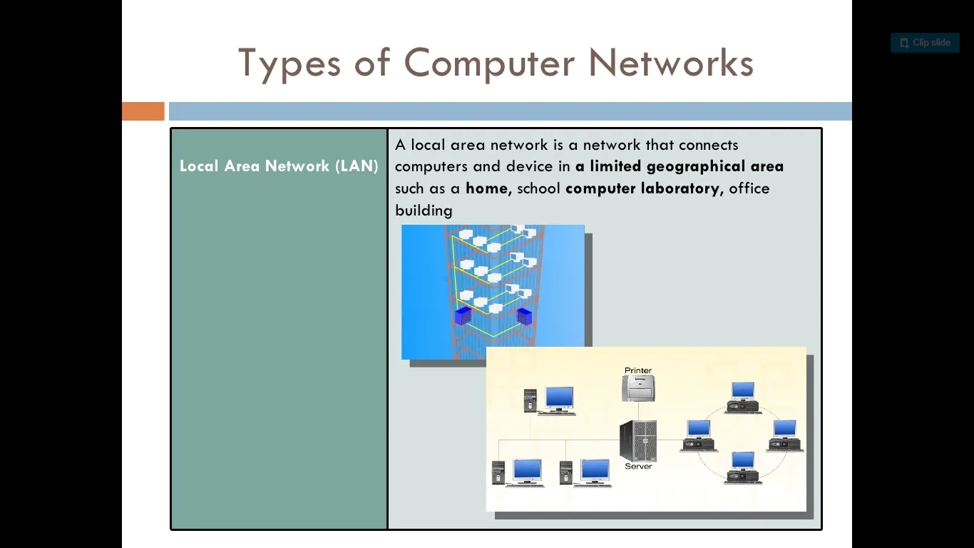
LAN
A Local Area Network (LAN) is a relatively small network that is confined to a small geographic area, such as a single office or a building. Laptops, desktops, servers, printers, and other networked devices that make up a LAN are located relatively close to each other. A key characteristic is that all of the equipment that comprises a LAN, is owned by a single entity.

Slide 14
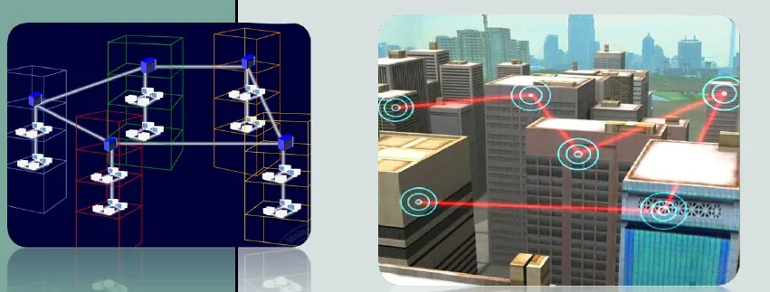
MAN
The term Metropolitan Area Network (MAN) is typically used to describe a network that spans a citywide area or a town.
MANs are larger than traditional LANs and predominantly use high-speed media, such as fiber optic cable, for their backbones.
This is often the case for hospitals that need to connect treatment facilities, outpatient facilities, doctor's offices, labs, and research offices for access to centralized patient and treatment information

Slide 15
WAN
A Wide Area Network (WAN) covers a significantly larger geographic area than LANs or MANs.
A WAN uses public networks, telephone lines, and leased lines to tie together smaller networks such as LANs and MANs over a geographically dispersed area.
Connecting devices in different geographic areas together for information sharing, WANs are an important piece of enterprise networks
Example : Visa net network

Slide 16
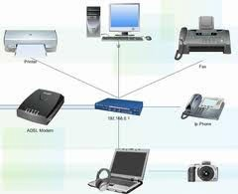
PAN
A more recent term used to describe a type of network is a Personal Area Network (PAN).
PAN networks are usually wireless, established in an on- demand or ad-hoc fashion when needed to communicate between two or more devices.
PAN networks can be used between devices owned by two different parties, or between two devices owned by one person, such as a PDA and a laptop or mobile phone.
These networks are usually characterized as short-range, often limited to 10 meters or less in range.
Example: Bluetooth

Slide 17
Network Architecture
Two classifications are
❑ Peer-to-Peer network
❑ Server based network

Slide 18
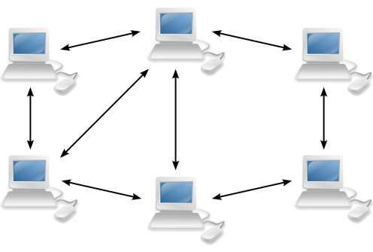
Peer to Peer network
Nodes provide and request services
User in each node administers resources
No extra investment
Easy to setup
Very weak security
Additional load on nodes

Slide 19
Peer-to-Peer Network :
In the P2P (Peer-to-Peer) network, “peers” generally represent computer system. These peers are connected to each other with help of Internet. Files might be shared directly without requirement of central server among these systems on the network. It can be said that each of computers on P2P network usually becomes file server even as client also. In this architecture, system is generally decomposed into various computational nodes that contain the same and equivalent capabilities, abilities, and responsibilities.

Slide 20
Advantages and disadvantages
Advantages of peer-to-peer networks:
Low cost
Simple to configure
User has full accessibility of the computer
Disadvantages of peer-to-peer networks:
May have duplication in resources
Difficult to uphold security policy
Difficult to handle uneven loading
Where peer-to-peer network is appropriate:
10 or less users
No specialized services required
Security is not an issue
Only limited growth in the foreseeable future

Slide 21
Client Server Application
Network Clients (Workstation)
Computers that request network resources or services
Network Servers
Computers that manage and provide network resources and services to clients
Usually have more processing power, memory and hard disk space than clients
Run Network Operating System that can manage not only data, but also users, groups, security, and applications on the network
Servers often have a more stringent requirement on its performance and reliability

Slide 22
Advantages and disadvantages
Advantages of client/server networks
Facilitate resource sharing – centrally administrate and control
Facilitate system backup and improve fault tolerance
Enhance security – only administrator can have access to Server
Support more users – difficult to achieve with peer-to-peer networks
Disadvantages of client/server networks
High cost for Servers
Need expert to configure the network
Introduce a single point of failure to the system

Slide 23
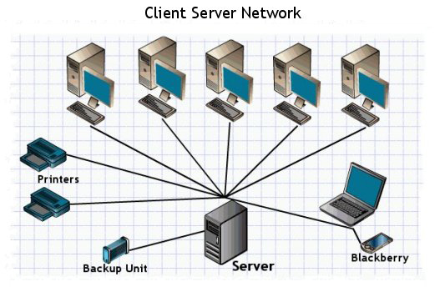
Application
File transfer protocol
Mail server
Application server
Message server
Proxy server
Database server
Web server

Slide 24
Local Area Network Overview
Applications
Personal computer LANs
  Low cost
  Limited data rate
Back end networks
  Interconnecting large systems (mainframes and large storage devices)
    High data rate
    High speed interface
    Distributed access
    Limited distance
    Limited number of devices

Slide 25
LAN applications
Storage Area Networks
  Separate network handling storage needs
  Detaches storage tasks from specific servers
  Shared storage facility across high-speed network
  Hard disks, tape libraries, CD arrays
  Improved client-server storage access
  Direct storage to storage communication for backup
High speed office networks
  Desktop image processing
  High capacity local storage
Backbone LANs
  Interconnect low speed local LANs
  Reliability
  Capacity
  Cost

Slide 26
LAN Architecture
Topologies
Transmission medium
Layout
Medium access control

Slide 27
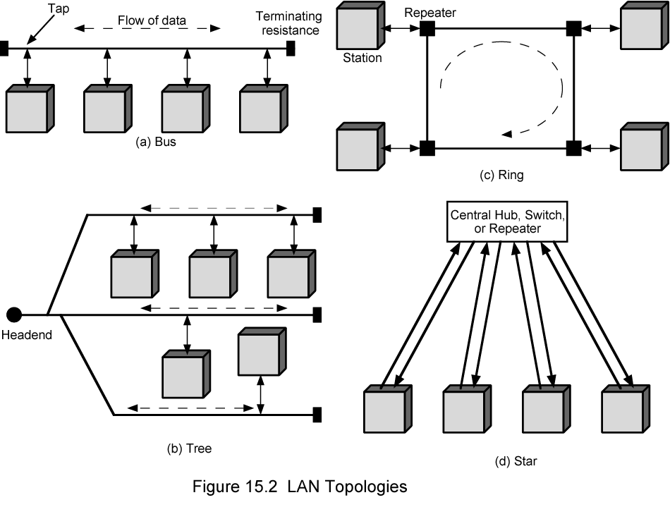
LAN Topologies

Slide 28
Choice of Topology
Reliability
Expandability
Performance
Needs considering in context of:
  Medium
  Wiring layout
  Access control

Slide 29
LAN transmission medium
Voice grade unshielded twisted pair (UTP)
  Cat 3
  Cheap
  Well understood
  Use existing telephone wiring in office building
  Low data rates
Shielded twisted pair and baseband coaxial
  More expensive than UTP but higher data rates
Broadband cable
  Still more expensive and higher data rate

Slide 30
LAN transmission medium
High performance UTP
  Cat 5 and above
  High data rate for small number of devices
  Switched star topology for large installations
Optical fiber
  Electromagnetic isolation
  High capacity
  Small size
  High cost of components
  High skill needed to install and maintain
    Prices are coming down as demand and product range increases

Slide 31
LAN transmission medium
Wireless Transmission
Frequency range (line of sight):
26 GHz to 40 GHz: for microwave with highly directional beam as possible
30 MHz to 1 GHz: for omni directional applications
300MHz to 20000 GHz: for infrared spectrum; used for point to point and multiple point application (line of sight)
Physical applications:
Terrestrial microwave – long haul telecommunication service (alternative to coaxial or optical fiber)
Few amplifier and repeaters
Propagation via towers located without blockage from trees, etc (towers less than 60 miles apart)
Wireless LAN
Hiper LAN (European standard; allow communication at up to 20 Mbps in 5 GHz range of the radio frequency (RF) spectrum
Hiper LAN/2 operate at about 54 Mbps in the same RF band

Slide 32
LAN design for Small business
Requirements:
• A CPA firm with 5 departments
• Total of 560 employees
• One building
• No current LAN operating
• Need for easy future expansion
• Need for fast access for each departmen
t • Reliability of the network

Slide 33
Design goals
• Functionality - the network must work with reasonable speed and reliability.
• Scalability - the network must be able to grow without any major changes to the overall design.
• Adaptability - the network must be designed with an eye toward future technologies, and should include no element that would limit implementation of new technologies as they become available.
• Manageability - the network would be designed to facilitate network monitoring and management.

Slide 34
Network design outline
Gathering the users requirements and expectations
• Determining data traffic patterns now and in the future based on growth and Server placements
• Defining all of the layer 1, 2 &3 devices and along with LAN and WAN topology
• Document the physical and logical network implementation

Slide 35
Methodology
• Analyze customer’s requirements
• Choose and Develop LAN structure (topology)
• Set up addressing and routing

Slide 36
Step 1: Analyse requirements
Business issues
• Technology issues
• Administrative issues

Slide 37
Some datas to be gathered
Corporate Structure – small CPA firm with 560 employees.
• Business information flow - ?
• Applications in use - ?
• Current topology - NONE
• Performance characteristics of current network - N/A
• Determine if documented policies are in place - ?
• Mission-critical data - ?
• Mission-critical operations - ?
• Approved protocols and platforms - ?
• Control versus distributed authority - ?
• Availability requirements –
• Throughput
• Response time
• Access to resources

Slide 38
Network load analysis
Client/Server applications
• Host/terminal applications
• Routing protocols
• Regularly scheduled services, such as file backup
• Estimate worst-case traffic load during the busiest times for users and during regularly scheduled network services

Slide 39
Step 2: choosing and developing topology
• Keeping in mind the first step requirements choose a suitable topology.
• In our case given the scarce requirements I would recommend a collapsed backbone topology .
• Another issue that comes into play is how Tall is the building and how are the departments physically located in it.

Slide 40
Step 3: Addressing and Routing
In this step the LAN engineer must carefully to consider where to place bridges and routers in order to minimize collision domains and to provide back up routes routs in case of bridge failures.
• Creating subnets and networks.
• Mapping physical and logical addressing.
• Develop and document the IP addressing scheme.

Slide 41
Selecting the Physical medium
• Considering the requirement for fast access and the possibility for a future expansion the best fitting LAN would be fast Ethernet
• With the same consideration in mind the specific choice would be 100Base-TX using CAT5(UTP or STP).

Slide 42
More specification
Choosing main distribution facility (MDF) and intermediate distribution facilities (IDF). MDF is usually placed in the base of the building, Whereas each floor can have its own IDF.
• Choice of backbone (vertical) cabling .
• Choice of horizontal cabling.

